Slide 1
Revolutionizing Healthcare: Developing an AI Model for Breast
Cancer Prediction

Slide 2

Introduction to AI in Healthcare
is transforming healthcare by providing innovative solutions for early diagnosis. This presentation explores the development of an AI model specifically designed for
, aiming to enhance patient outcomes and streamline diagnostic
processes.

Slide 3

Understanding Breast Cancer
Breast cancer is one of the most prevalent cancers among women. Early detection is crucial for .
Understanding the and symptoms can lead to timely medical intervention and significantly improve survival rates.

Slide 4
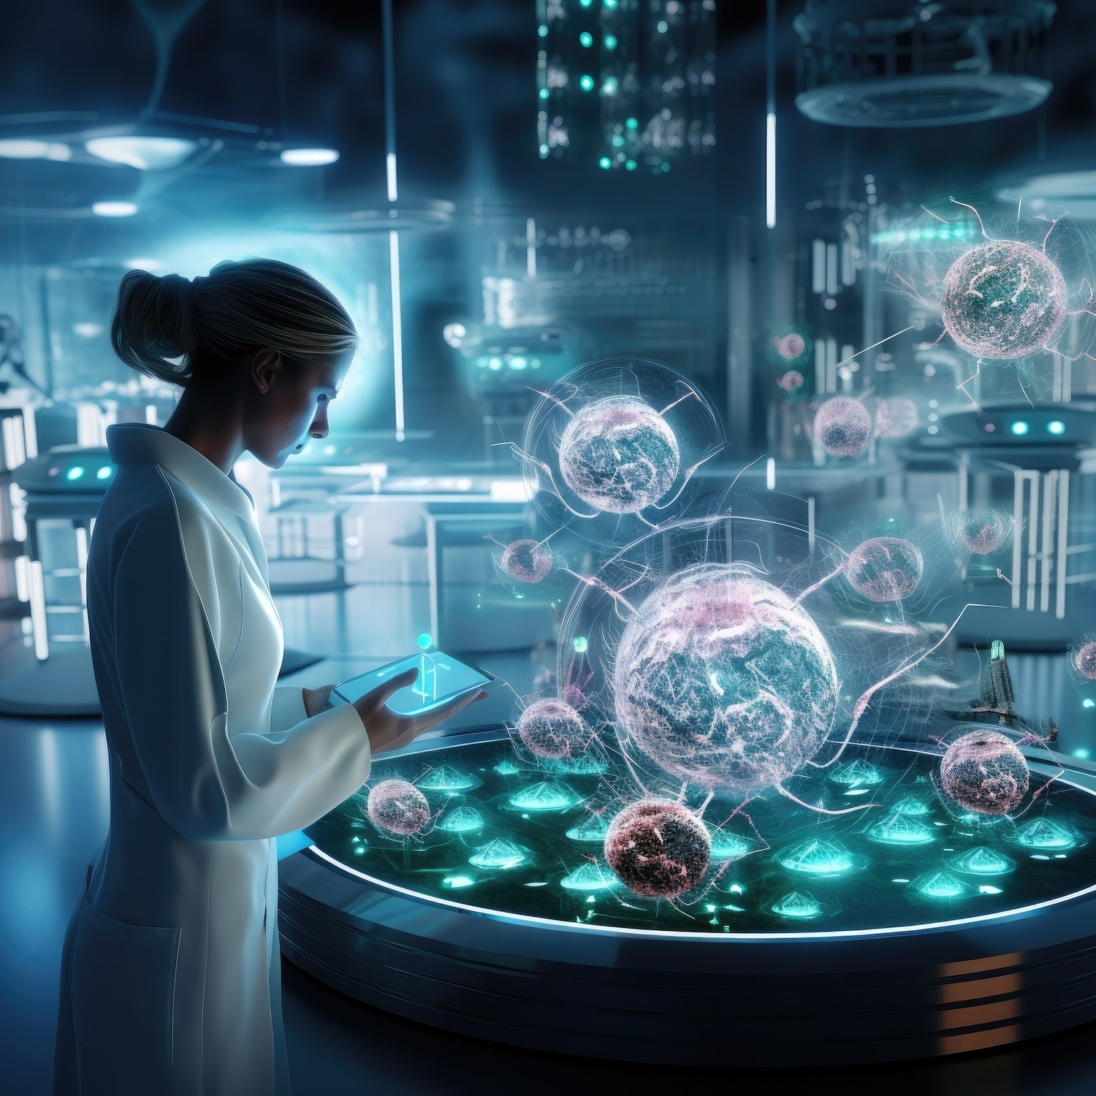
Technological Innovations in Predictions
The integration of Artificial Intelligence and Machine Learning in breast cancer prediction models has revolutionized the way we analyze data. These technologies enable more accurate risk assessments and personalized treatment plans, ultimately leading to better patient outcomes.

Slide 5


AI Model Development Process
Developing an effective AI model involves several steps: data collection, preprocessing, model selection, and training. The model is designed to analyze and patient data to predict breast cancer risk with high accuracy.

Slide 6
Steps to Make the Model
Dataset
Data
Pre-processing
Implementing various M.L techniques **
Patient New Data
Cleaning
Transforming
Prediction of cancer
Feature Selection
Test Data
Train Data
Generating Report

Slide 7
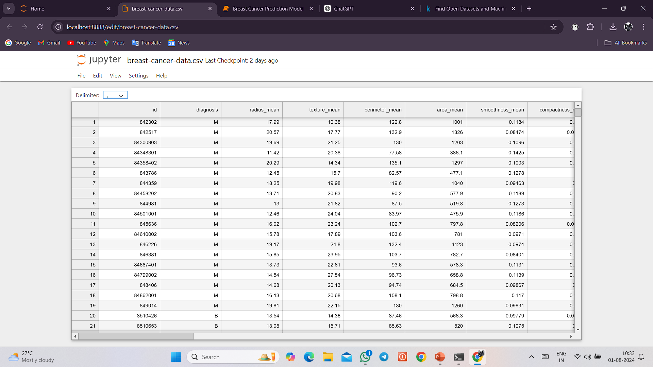
Visualization of the Features
Radius (mean of distances from the center to points on the perimeter)
Texture (standard deviation of gray-scale values)
Perimeter
Area
Smoothness (local variation in radius lengths)
Compactness (perimeter^2 / area - 1.0)
Concavity (severity of concave portions of the contour)
Concave points (number of concave portions of the contour)
Symmetry
Fractal dimension ("coastline approximation" - 1)

Slide 8
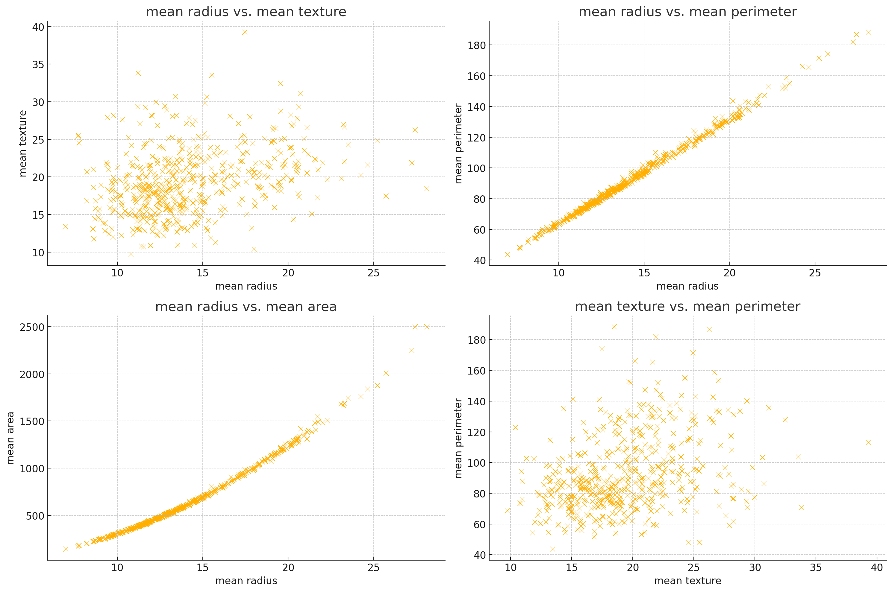
1. Mean Radius vs. Mean Texture
Observation:The plot reveals a fairly scattered distribution, indicating that there is no strong linear correlation between the mean radius and the mean texture. Tumors with a similar radius can have a wide
range of textures.
2. Mean Radius vs. Mean Perimeter
Observation: There is a strong positive linear correlation between the mean radius and the mean perimeter. As the radius of the tumor increases, the perimeter also increases proportionally. This makes sense geometrically since the perimeter of a circle is directly proportional to its radius.
3. Mean Radius vs. Mean Area
Observation: There is a strong positive non-linear (quadratic) correlation between the mean radius and the mean area. As the radius increases, the area increases more rapidly.
4. Mean Texture vs. Mean Perimeter
Observation: There is a scattered distribution similar to the first plot, indicating no strong linear correlation between mean texture and mean perimeter. Tumors with a similar perimeter can have a wide range of textures.

Slide 9
Techniques Used for the Project
Decision Tree
Random Forest Classification
Support Vector Classifier
Neural Network

Slide 10
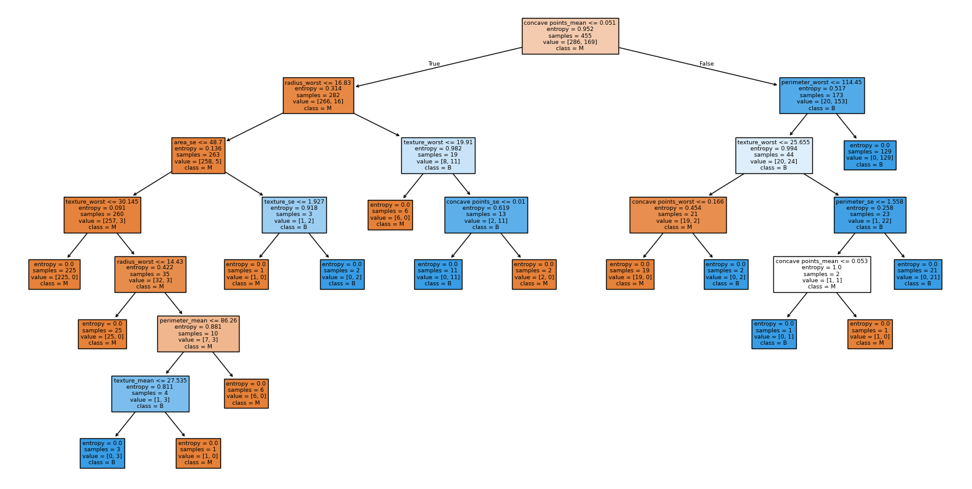
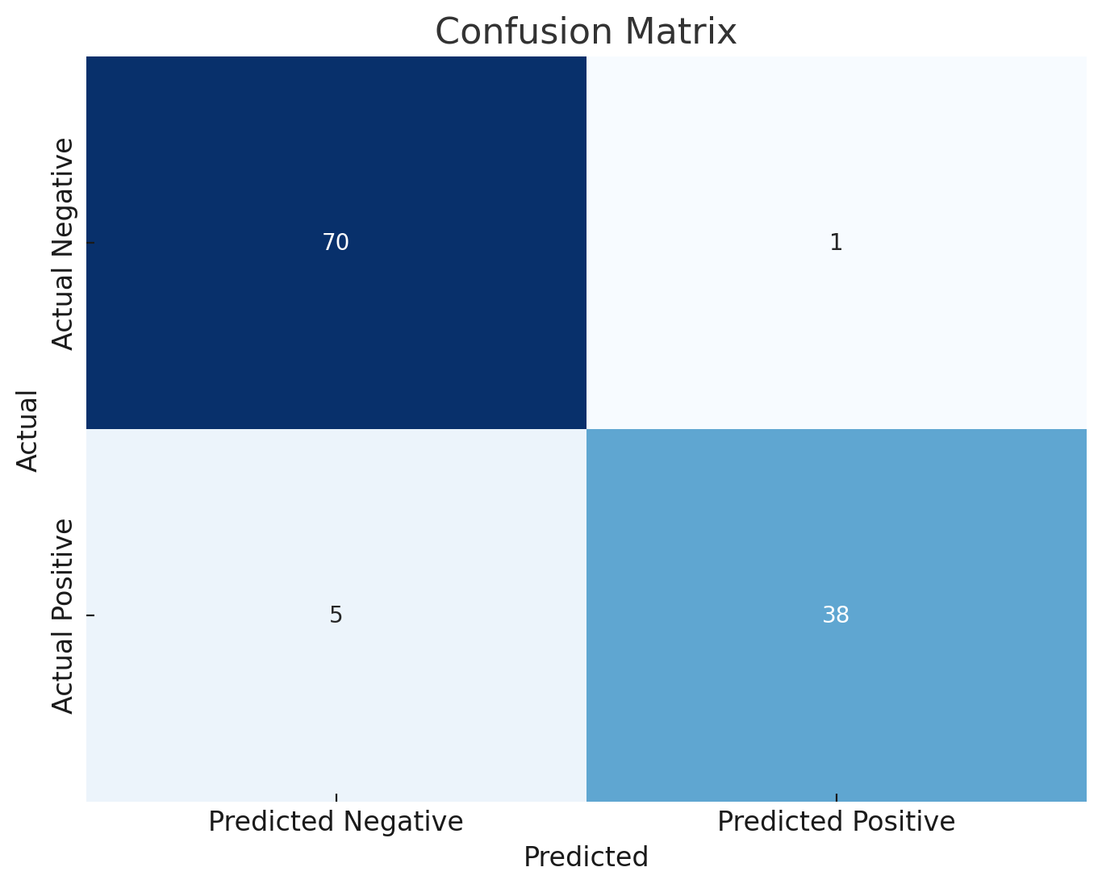
Decision Tree
This Model yielded 94.73% Accuracy for the prediction after taking the training size to 80% of the Data.
This Model had 6 cases where the data was predicted to be wrong from which there are 5 False negative cases.

Slide 11
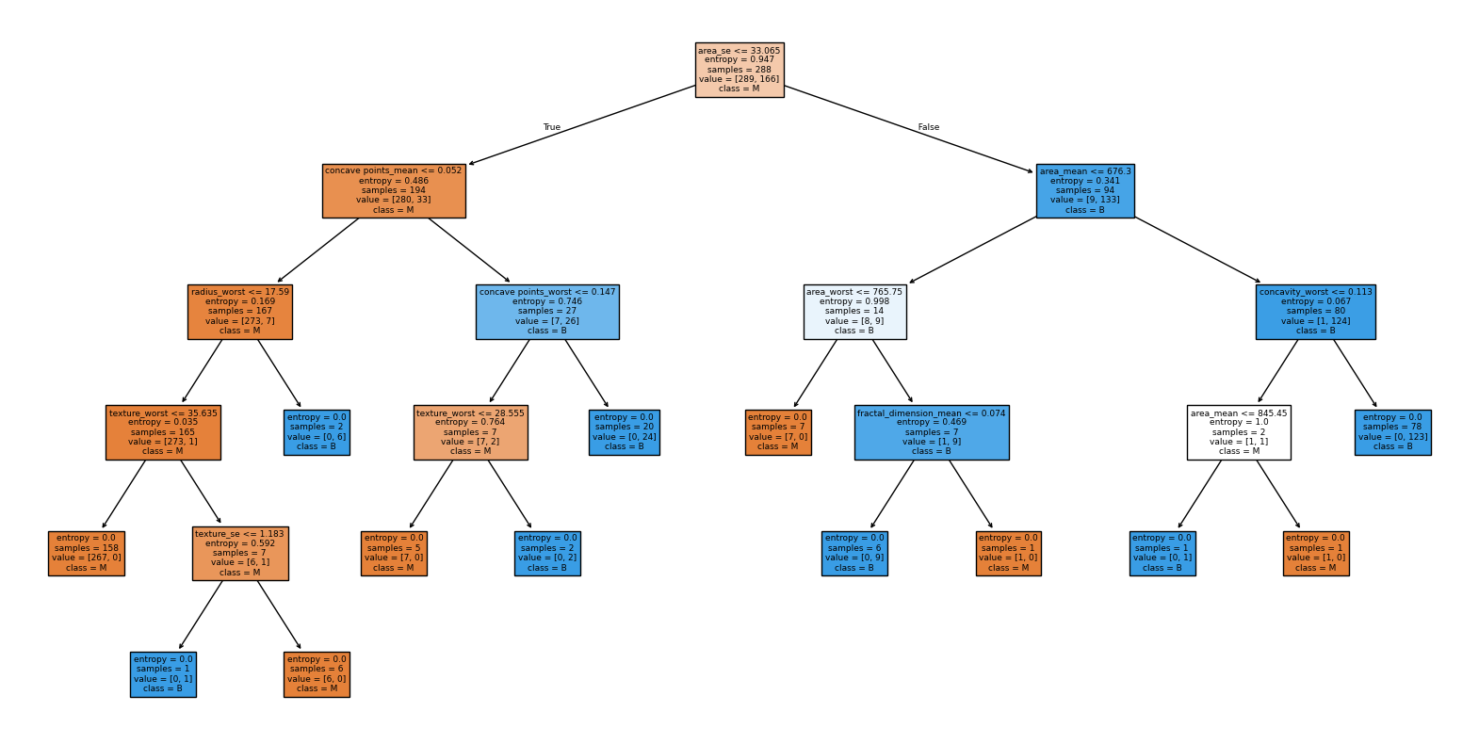
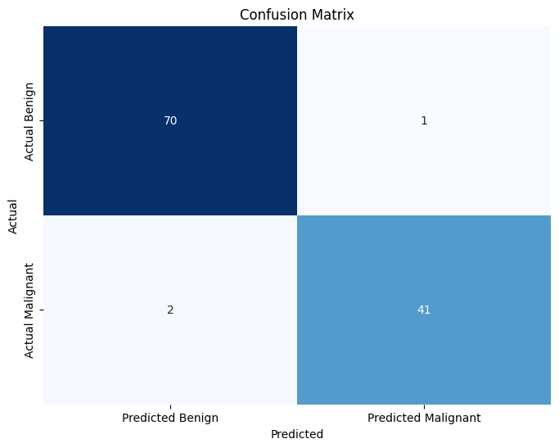
Random Forest Classifier
This model is the better version of the decision tree while doing large and complex databases, and this model yielded 97.36% of accuracy.
This model had 3 cases where the data was predicted to be wrong from which there are 2 false negative cases

Slide 12

Support Vector Classifier
This Model yielded 95.61% of the accuracy, which makes it a better model than the decision tree model.
This model had 5 cases of wrong predictions from there were 4 false negative cases.

Slide 13
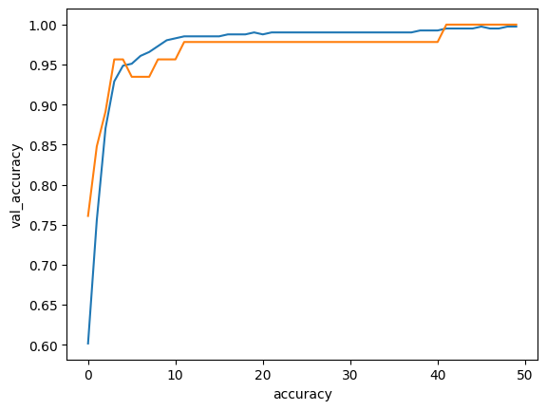
Neural Network
This model yielded 97.36% of accuracy which is the same as the random forest model. We used 50 epochs for the model.
This may suggest that the highest accuracy achieved by any technique is similar to random forest model.
This model had 3 wrong cases from which 2 were false negative cases.

Slide 14
Real time Usage of the Project
The last two decades a variety of different ML techniques and feature selection algorithms have been widely applied to disease prognosis and predictions.
This model provided that it gets accurate data can be used in clinical practice as a medical tool
This model will help in reducing the human efforts which will help doctors to take proper decisions and steps on time resulting in the benefit of patient and overall society.

Slide 15

Data Sources and Features
The AI model utilizes diverse data sources, including medical records imaging data, and genetic information. Key features such as age, family history, and tumor characteristics are
crucial for improving prediction accuracy.

Slide 16


Results and Impact
Preliminary results indicate that the AI model significantly improves early detection rates of breast cancer. The impact on patient care includes reduced diagnostic time and increased
, ultimately leading to better
patient outcomes.

Slide 17
Conclusion and Future Directions
The development of an AI model for breast cancer prediction represents a significant advancement in healthcare. Future directions include refining the model, expanding data sources, and exploring integration into clinical practice for real-time decision support.

Slide 18
QNA Time

Slide 19
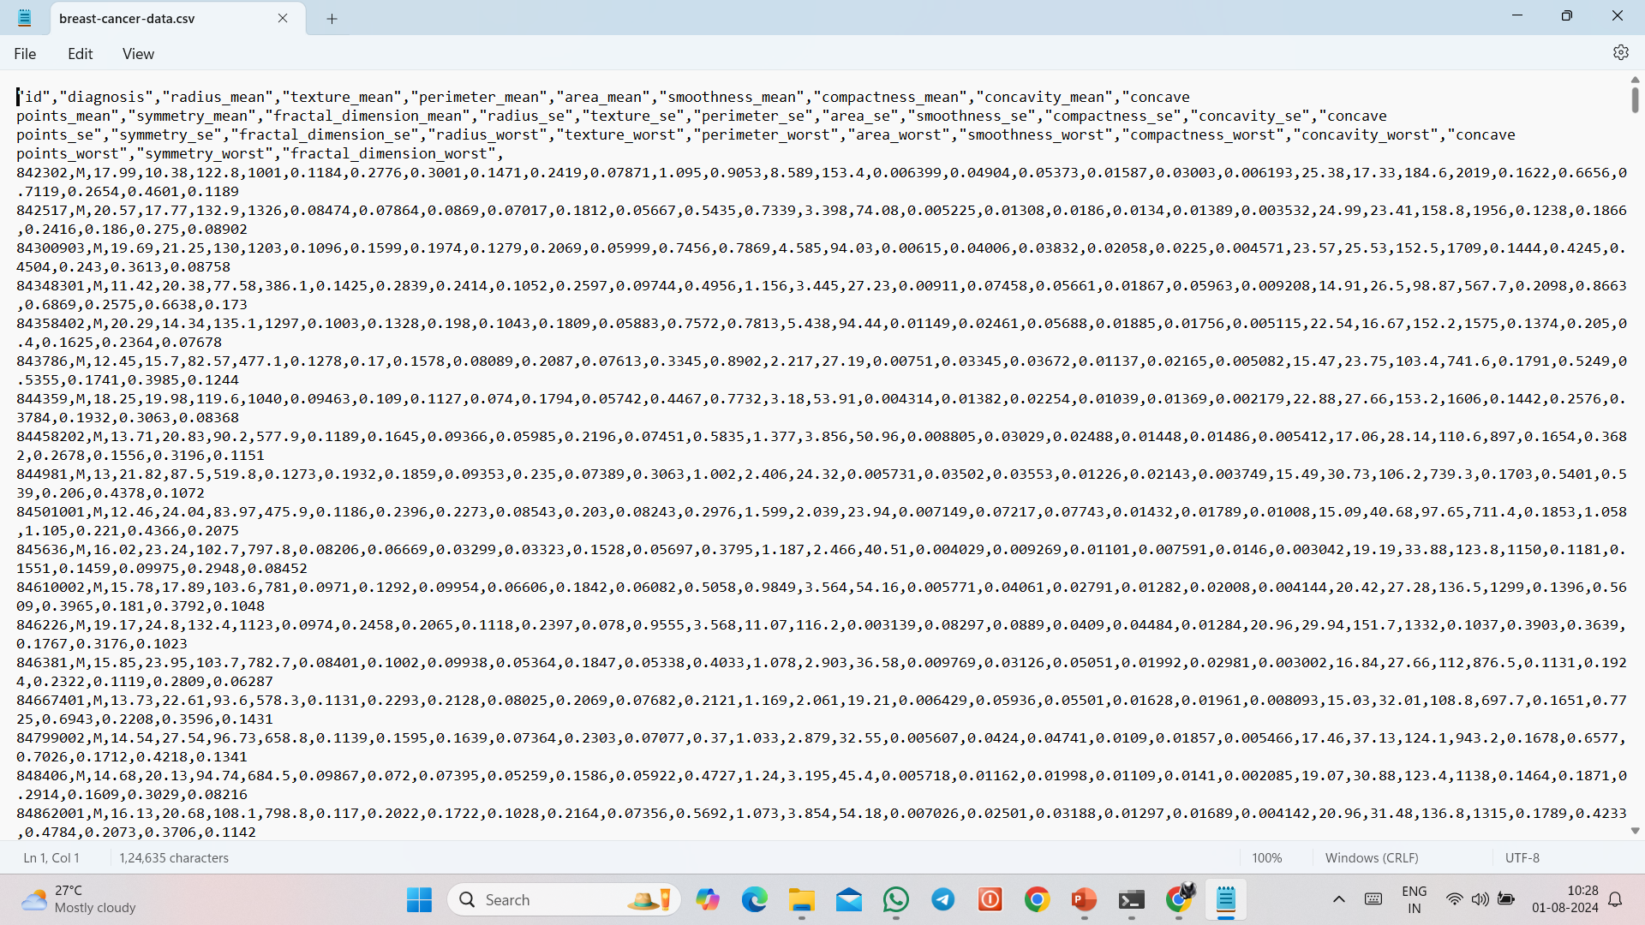
References
https://www.kaggle.com/datasets/yasserh/breast-cancer-dataset

Slide 20

Thanks!
arjavjain_2494
aggarwal_yash
supersam9276
Made by:
Arjav Jain
Saurabh Sharma
Swayam Bansal
Yash aggarwal

